Slide 1
Workbook Integration Blueprint
Internal Use Only
April 2017

Slide 2
Disclaimer
The content of this workbook has been produced by KPMG Germany/Deal Advisory on the basis of German accounting standards and/or IFRS, as well as considering KPMG Germany’s firm and country requirements, regulations, processes, policies and best practices. Please check your local accounting and other requirements before applying the content.

Slide 3
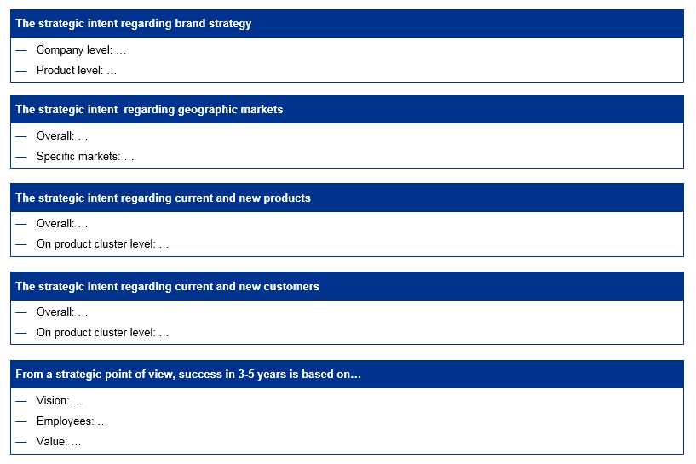
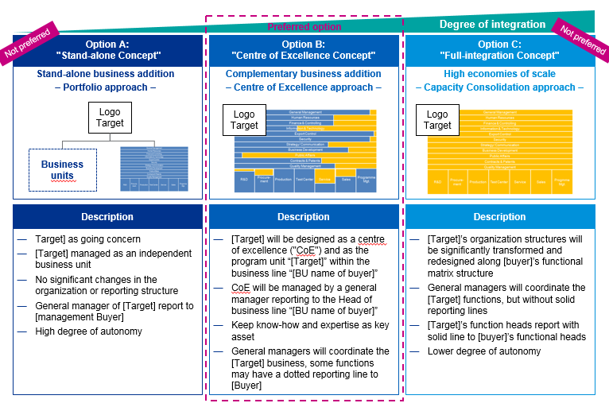
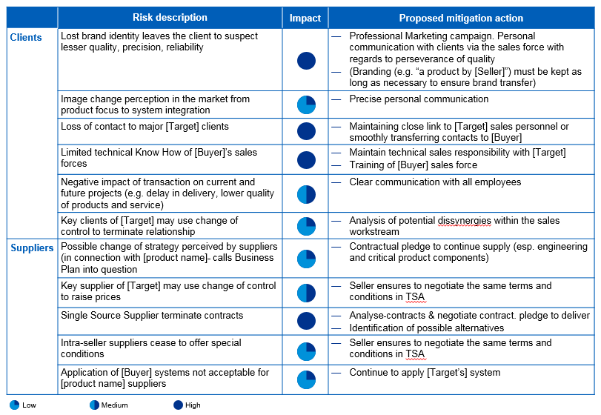
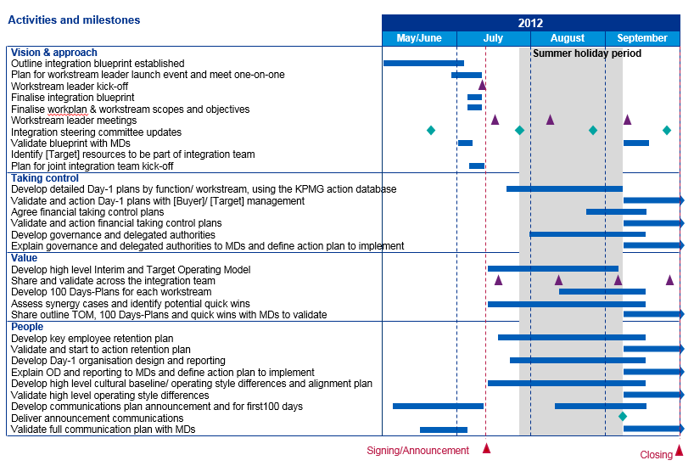
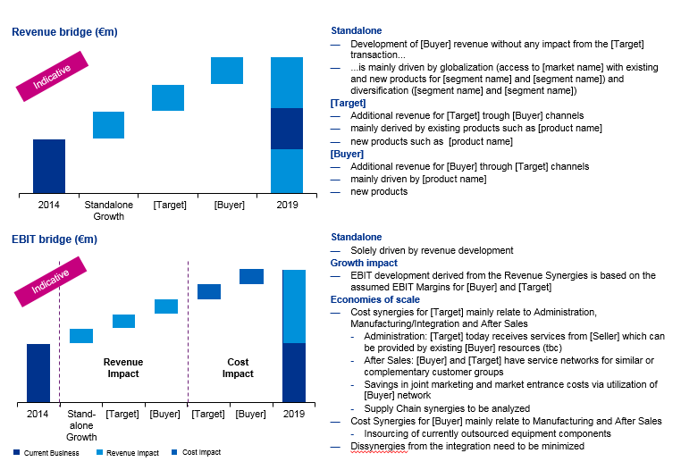
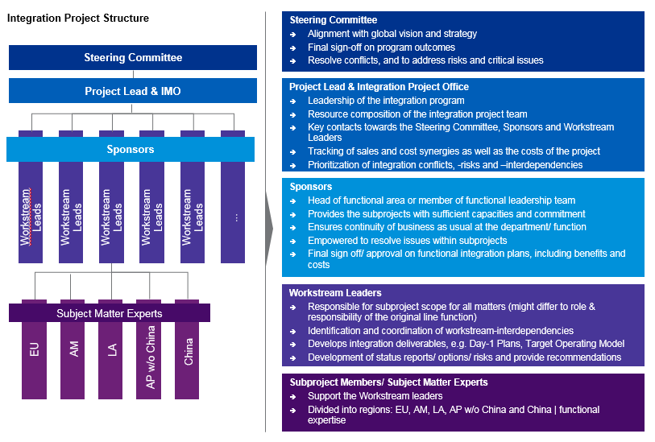
Overview (1/7) – Mission statement
Integration Blueprint
Mission Statement:
Provides a clear definition of the integration targets and the primary guidelines. The document offers a joint orientation for the management and is the basis for additional components in the framework of integration
Customer situation
Definition/Methodology/Tools of the basis analysis
Sell Side/JV
The blueprint is one of the first deliverables in an integration project
Serves as an on-boarding document for customer’s project members
Sets the “Guidelines for integration“
The Target Operating Model builds upon the blueprint
The blueprint is drawn up for both integrations and joint ventures
JV blueprints are in principle set up the same with a special focus on questions of governance as well as revenue/cost sharing
Definition
The rationale for the integration is summarized in the blueprint and the management principles for the integration determined. It therefore forms the “guidelines” of the integration (and of the JV). Initial considerations for a high level target operating model, synergy goals, project plan and governance and the primary challenges and risks (including measures) are also a part of the document
The blueprint serves as the on-boarding document for the customer’s project members and represents the basis for the resulting deliverables (e.g. target operating model)
Methodology
During the workshops with the top and senior management it is attempted to channel the strategic considerations and to reproduce these in a strategy mix
Tools and templates
Degree of standardization
The Integration Blueprint is a PowerPoint document with predefined subjects / structure

Slide 4
Overview (2/7) – Pitfalls
Integration Blueprint
No. | Pitfalls/Lessons learned
 | The customer has to deliver the answers themselves. KPMG facilitates, asks the “right” questions and forwards lessons learned from project experience
 | Inclusion of the target management in an “off-site“ alignment workshop has proven to be very helpful. In this way erroneous outside-in assumptions on the organizational structure, processes and products can be avoided. In addition, the acceptance of the blueprint by the target is improved
 | A good blueprint provides momentum for the process of generating TOM and day-1 readiness. A flawed/inconsistent document significantly hinders the integration process
 | Synergy goals that the buyer determined in the framework of the due diligence/investment proposal, must be subjected to an initial high level review/validation as early as possible. Meetings with the customer’s staff that participated in the investment business case are necessary for the overall understanding
 | Should the timeline have been set too tight by the buyer, this should be identified as a key risk early in the process
 | The management should approve key talent/retention measures at an early date and attune the communication with the blueprint strategy
 | Project structure: When appointing workstream sponsors and leads, it should be checked in detail if the correct responsibles have been selected. Sponsors that are “too senior” or are seldom available due to international tasks, may not be in a position to fulfil the function. Poor choices and the associated subsequent nominations delay the project and have a negative impact on the “project climate”. Furthermore, it is decisive that the workstream lead is guaranteed enough free space from the daily operations. Integration projects tie up a significant amount of capacity (see data on workload on pages 15-16)
1
2
3
4
5
6
7

Slide 5
Overview (3/7) – Core issues
Integration Blueprint
Core Issue | Specific analysis | Page(s)
What vision is being followed? What is the basic rationale behind the deal? | Structured interviews with the top management | 11
2. What are the initial considerations for the operational target model? To what extent should Buyer and Target be integrated/stand-alone? | Presentation of the information gained in the management interviews on the depth of integration | 12
What are the guiding principles that have to be observed operatively? | Initial high level information on the target operating model. Bundling the knowledge from the interviews with the responsible for all the relevant functions | 13
What financial goals/synergy targets (high level) must be achieved? | Revenue and/or EBIT bridge: From standalone to integrated company, including synergy goals (if set). Data will be taken from the (Buyer) management case in the due diligence | 14
What is the expected timeline of the project? What milestones have to be achieved? | Overview of the timeline with milestones, explanation of the project set-up with key deliverables | 15-16
What are the possible risks and how can these be mitigated? | Knowledge from the interviews conducted, bundled as overview about the material risks along the points customer, sales, staff, and other, including recommendations for action to address the identified risks | 17-18
How is the project governance/structure set up? How does the project management represent itself? | Overview of project structure, workstreams, governance, roles and responsibilities | 19-23

Slide 6
Overview (4/7) – Placement in the overall integration process
Integration Blueprint
4 weeks
10-12 weeks^{(a)}
100 days
100 days +
Pre-Signing
Pre-Closing
Post-Closing first 100-Days
Beyond the ...deal
Beyond the ...deal
Signing
Completion/Day 1
100 Days
Objective:
Validation and documentation of the strategic rationale, primary value drivers, initial indications for planned target operating model as well as high level synergies
Documentation and approval:
Deal rationale
Depth of integration
Risks and measures
High level target structure (organization)
High level synergy assessment
Stakeholder mapping and approved communications elements
Timeline for the integration
Objective:
Guarantee “day-1 readiness“ for control over the process, the integration goals and the daily business as of closing; target operating model and synergy case
Documentation and approval:
“Take control“ as of day of closing
As-is, interim and target operating model
Change management, culture and retention plan
Synergy case
Communication plan
Objective:
Avoid disruptions in the daily business; realization of quick wins and start of a quick and effective integration
Implementation:
Realized quick wins
Adjusted financial business plan (bottom-up)
Robust benefit & synergy tracking including corresponding project structure
Initial validation/Detailing TOM
Objective:
Conclusion of the integration and identification of additional optimization potentials
Realized synergies
Identification of value levers and implementation of on-going optimization measures
Integration review, lessons learned
Perform “second wave of integration“ if necessary
Vision and
approach
Value
Control
People and culture
PMO
Objective
Supported by the introduction of suitable processes, controls and monitoring functions (with sufficient resources) the trouble-free start and straightforward course of the project as well as the fulfilment of the goals
Note: (a) The time between signing and closing may be between 0 (same day) and several months

Slide 7
Overview (5/7) – Platform to align key stakeholders and to foster effective integration work and decision making
Integration Blueprint
INTEGRATION BLUEPRINT
Objectives
On-boarding document for the integration of buyer and target, setting the overall course of the integration
Consolidated opinion and direction setting amongst Integration Director, top management and key decision makers
Defines integration fundamentals, platform for top management alignment
Guidance for new project members and framework for development of all further deliverables
Target Operating Model
Integration Principles
Deal Background
Approach
Analysis of relevant documents (deal proposal, DD reports, decision memo, organization charts, …)
10-15 Top Management interviews by KPMG experienced integration leaders (ideally with both buyer and target)
Corporate background from previous integrations ("Lessons learned")
Integration Hotspots
Integration Approach

Slide 8
Overview (6/7) – Blueprint elements
Integration Blueprint
Deal Background
Strategy and deal rationale (regional/content expansion)
Company overviews/introductions: organization, product portfolio, markets and customers
Objectives: financial and synergy targets, non-financial objectives
Target Operating Model
Organization design principles: customer vs. product-driven, span of control, etc. ("future proof set-up")
High level target organization chart ("boxes only")
Leadership nomination approach ("names to boxes")
Target Operating Model
Integration Principles
Deal Background
Integration Principles
Integration and operating principles (define borderlines for integration work, decision criteria, integration depth per function)
Stakeholder matrix and communication roadmap (draft)
Integration roadmap (achievements after +30 .. 60 .. 100 .. 300 days)
Integration Hotspots
Integration Approach
Integration Hotspots
Day-1 must haves (payroll, compliance, treasury, LoA, ...)
Integration risks (customer deterioration, employee retention, ...)
Initial cultural assessment (outside in)
Integration Approach
Integration set-up (project structure, time allocation, involvement Pyramid management)
Integration timeline
Integration methodology

Slide 9
Overview (7/7) – Approach
Integration Blueprint
Details on Methodology/Approach
1
2
3
Form hypotheses
Interviews & documentation
Coordination & approval
Further integration/JV approach
Form hypotheses
Interviews & documentation
Coordination and approval
1
2
3
Approach:
Review of the available information on buyer and target:
Business reports
Information Memo
Management presentation, e.g. investment proposal
Management case including synergies (if available)
Due diligence documents (if available)
Coordination with project head/integration director on the customer side which managers should be invited to individual interviews
Make appointments for the interviews
Initial assumptions/hypotheses
Approach:
Performance of individual interviews with standardized questions on the subjects of
Deal rationale
Depth of integration
Indications for organizational target structure
Key risks and measures
“Non-negotiables/deal breakers“
Synergies
Stakeholder
Bundling of the interview results
Highlighting of open issues for approval in alignment workshop
Definition of critical success factors
Approach:
The blueprint will be developed in an off-site alignment workshop (at least one day long) together with the steering committee and if possible with the operational project lead (Buyer)
Here the entire document will be reviewed jointly to reach a consensus on every subject
If necessary, the management of the target will be included in an additional kick-off meeting
At the end of the alignment workshop the document will be approved and presented to the whole project team during the kick-off meeting
Process steps

Slide 10
1. What vision is being followed? What is the basic rationale behind the considerations?
Integration Blueprint
Core Statements:
The deal rationale is validated with the parameters brand, regions, products and customers
The strategic intent regarding brand strategy
Company level: …
Product level: …
The strategic intent regarding geographic markets
Overall: …
Specific markets: …
The strategic intent regarding current and new products
Overall: …
On product cluster level: …
The strategic intent regarding current and new customers
Overall: …
On product cluster level: …
From a strategic point of view, success in 3-5 years is based on…
Vision: …
Employees: …
Value: …

Slide 11
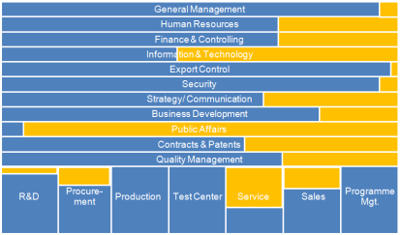
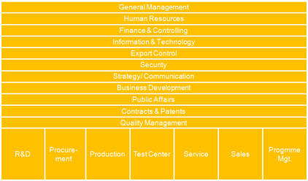
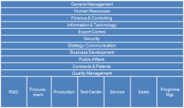
2. What are the initial considerations for the operational target structure? To what extent should they be integrated/separated?
Integration Blueprint
Core statements:
Centre of excellence is the preferred integration model
The target is integrated as a separate Business Line of the sub-group
The Managing Director of the target reports to the Head of the Business Line
No change in the personnel structure
Degree of integration
Preferred option
Option A: "Stand-alone Concept"
Option B: "Centre of Excellence Concept"
Not preferred
Not preferred
Option C: "Full-integration Concept"
Stand-alone business addition
– Portfolio approach –
Complementary business addition
– Centre of Excellence approach –
High economies of scale
– Capacity Consolidation approach –
Logo Target
Logo Target
Logo Target
Business units
Description
Description
Description
[Target] as going concern
[Target] managed as an independent business unit
No significant changes in the organization or reporting structure
General manager of [Target] report to [management Buyer]
High degree of autonomy
[Target] will be designed as a center of excellence ("CoE") and as the program unit “[Target]” within the business line “[BU name of buyer]”
CoE will be managed by a general manager reporting to the Head of business line “[BU name of buyer]”
Keep know-how and expertise as key asset
General managers will coordinate the [Target] business, some functions may have a dotted reporting line to [Buyer]
[Target]’s organization structures will be significantly transformed and redesigned along [buyer]’s functional matrix structure
General managers will coordinate the [Target] functions, but without solid reporting lines
[Target]’s function heads report with solid line to [buyer]’s functional heads
Lower degree of autonomy

Slide 12
3. What are the guiding principles that have to be observed operatively?
Integration Blueprint
Core statements:
Implementation of the minimum requirements for the buyer’s standards as of closing for
External accounting
Internal controlling
Treasury
Implementation of the target operating model after 12 months
All services of the seller are shifted to the buyer in the TOM
NO change of personnel structure
Functions | Degree of integration/operating principles | Speed | Non-negotiables
Finance & Controlling | Interim Operating Model Organization: Solid reporting line from [Target] Mgmt to [Buyer] Mgmt No changes in team organizational structure Processes: External Accounting Minimum requirements to fulfill [Buyer] standards need to be in place Internal Management Controlling Minimum requirements to fulfill [Buyer] standards need to be in place Treasury New [Target] cash accounts in place New guarantees to be granted by [Buyer] Coordination with F&C of [Buyer] Reporting to be set up on standards of [Buyer] Planning tools/ERP unchanged at [Target] Target Operating Model Organization: Current team organizational structure remains in place Processes: External Accounting All requirements to fulfill [Buyer] standards need to be in place Internal Management Controlling All requirements to fulfill [Buyer] standards need to be in place Treasury See Interim Operating Model Services provided by seller to be transferred to [Buyer] Complete integration of F&C department (including standards and procedures) of [Buyer] Full IT-integration (Timeline, costs: tbc) | Interim Operating Model: Day 1 Target Operating Model: External Accounting (12 months) Internal Management Controlling (12 months) Treasury (12 months) | [Buyer] standards to be adopted after a transition period
Example for Finance
Apply for all functions!

Slide 13
4. What financial goals (high level) must be achieved?
Integration Blueprint
Core statements:
Ambitious timeline for synergies (sales and costs) in the coming 5 years
Sales synergies impact on target and on buyer sides through joint use of the sales network and the joint distribution of combined products
Revenue bridge (€m)
Standalone
Development of [Buyer] revenue without any impact from the [Target] transaction...
...is mainly driven by globalization (access to [market name] with existing and new products for [segment name] and [segment name]) and diversification ([segment name] and [segment name])
[Target]
Additional revenue for [Target] trough [Buyer] channels
mainly derived by existing products such as [product name]
new products such as [product name]
[Buyer]
Additional revenue for [Buyer] through [Target] channels
mainly driven by [product name]
new products
Indicative
EBIT bridge (€m)
Standalone
Solely driven by revenue development
Growth impact
EBIT development derived from the Revenue Synergies is based on the assumed EBIT Margins for [Buyer] and [Target]
Economies of scale
Cost synergies for [Target] mainly relate to Administration, Manufacturing/Integration and After Sales
Administration: [Target] today receives services from [Seller] which can be provided by existing [Buyer] resources (tbc)
After Sales: [Buyer] and [Target] have service networks for similar or complementary customer groups
Savings in joint marketing and market entrance costs via utilization of [Buyer] network
Supply Chain synergies to be analyzed
Cost Synergies for [Buyer] mainly relate to Manufacturing and After Sales
Insourcing of currently outsourced equipment components
Dissynergies from the integration need to be minimized
Indicative
Current Business
Revenue Impact
Cost Impact

Slide 14
5. What is the exact timeline of the project? What milestones have to be achieved? (1/2)
Integration Blueprint
Core statements:
2.5 months between signing and closing for the development of the TOM and the assurance of day-1 readiness
Activities and milestones
2012
May/June
July
August
September
Vision & approach
Summer holiday period
Outline integration blueprint established
Plan for workstream leader launch event and meet one-on-one
Workstream leader kick-off
Finalize integration blueprint
Finalize workplan & workstream scopes and objectives
Workstream leader meetings
Integration steering committee updates
Validate blueprint with MDs
Identify [Target] resources to be part of integration team
Plan for joint integration team kick-off
Taking control
Develop detailed Day-1 plans by function/workstream, using the KPMG action database
Validate and action Day-1 plans with [Buyer]/[Target] management
Agree financial taking control plans
Validate and action financial taking control plans
Develop governance and delegated authorities
Explain governance and delegated authorities to MDs and define action plan to implement
Value
Develop high level Interim and Target Operating Model
Share and validate across the integration team
Develop 100 Days-Plans for each workstream
Assess synergy cases and identify potential quick wins
Share outline TOM, 100 Days-Plans and quick wins with MDs to validate
People
Develop key employee retention plan
Validate and start to action retention plan
Develop Day-1 organization design and reporting
Explain OD and reporting to MDs and define action plan to implement
Develop high level cultural baseline/operating style differences and alignment plan
Validate high level operating style differences
Develop communications plan announcement and for first 100 days
Deliver announcement communications
Validate full communication plan with MDs
Signing/Announcement
Closing

Slide 15
5. What is the exact timeline of the project? What milestones have to be achieved? (2/2)
Integration Blueprint
Core statements:
Deliverables of the project are
Workstream charter
TOM
Day-1 plans
100 Day plans
Culture
100-day plans
Plan the activities of the first months after closing
DAY-
1
Target Operating Model
Define Interim and Final Operating Model per function
Organization design
Synergy case
100 days
Workstream charters
Define objectives and sub-projects of the workstream
As-is
Develop understanding of [Buyer]‘s/ [Target]‘s organization and processes
Cultural alignment plan
Day-1 plans (e.g. readiness, RPDA)

Slide 16
6. What are the possible risks and how can these be addressed? (1/2)
Integration Blueprint
Core statements:
The integration bears risks in the realms of customers and suppliers. Anticipated risks can be mitigated by pre-defined measure
 | Risk description | Impact | Proposed mitigation action
Clients | Lost brand identity leaves the client to suspect lesser quality, precision, reliability |  | Professional Marketing campaign. Personal communication with clients via the sales force with regards to perseverance of quality (Branding (e.g. “a product by [Seller]”) must be kept as long as necessary to ensure brand transfer)
 | Image change perception in the market from product focus to system integration |  | Precise personal communication
 | Loss of contact to major [Target] clients |  | Maintaining close link to [Target] sales personnel or smoothly transferring contacts to [Buyer]
 | Limited technical Know How of [Buyer]’s sales forces |  | Maintain technical sales responsibility with [Target] Training of [Buyer] sales force
 | Negative impact of transaction on current and future projects (e.g. delay in delivery, lower quality of products and service) |  | Clear communication with all employees
 | Key clients of [Target] may use change of control to terminate relationship |  | Analysis of potential dissynergies within the sales workstream
Suppliers | Possible change of strategy perceived by suppliers (in connection with [product name] calls Business Plan into question |  | Contractual pledge to continue supply (esp. engineering and critical product components)
 | Key supplier of [Target] may use change of control to raise prices |  | Seller ensures to negotiate the same terms and conditions in TSA
 | Single Source Supplier terminate contracts |  | Analyze contracts & negotiate contract. pledge to deliver Identification of possible alternatives
 | Intra-seller suppliers cease to offer special conditions |  | Seller ensures to negotiate the same terms and conditions in TSA
 | Application of [Buyer] systems not acceptable for [product name] suppliers |  | Continue to apply [Target’s] system
Low
Medium
High

Slide 17
6. What are the possible risks and how can these be addressed? (2/2)
Integration Blueprint
Core statements:
The integration bears risks in the realm of employees and diverse other subjects such as a very tight timeline. Anticipated risks can be mitigated by pre-defined measures
 | Risk description | Impact | Proposed mitigation action
Em-ployees | Lost/Demotivated key-personnel |  | Clear communication of roles & perspectives Creation of valuable positions by responsibilities Team events, communication, active involvement Identification of key employees and development of personalized engagements Customized integration into [Buyer] structure Risk analysis and development of customized People Engagement plans Accentuating the preservation of [Target] sites
 | Manage personal resources overload |  | Identification of overload and clear prioritization of tasks
Other | Business Plan risk: Revenue shift leads to overcapacities |  | Rolling personnel planning on [Target]’s side (quantitative and qualitative)
 | Loss or delay of revenue impacts due to exportability constraints |  | Utilize strong [Buyer] support in export
 | Integration too ambitious on the timeline |  | Main targets: the fulfillment of the M&A business case and the stabilization of daily business
Low
Medium
High

Slide 18
7. What does the project management look like? (structure, roles, resources, responsibilities? (1/5)
Integration Blueprint
Core statements:
Cascading project structure
Steering committee filled with Buyer, Seller and Target management
Dual workstreams with project members from Buyer and Target (if needed also Seller, e.g. in connection with SLAs)
KPMG Engagement Partner
Steering Committee
Management of Buyer, Seller and Target
PMO
KPMG Lead
….
KPMG PMO
…
Integration Leadership Team (operational)
Representatives of Buyer, Seller and Target (Members of the Steering Committee can also be part of the operational Integration Leadership Team)
Value Chain Workstreams
KPMG: N.N.
Support Function Workstreams
KPMG: N.N.
Purchasing/Sourcing
Product Support/ASS
Synergies
Finance
Strategy
Buyer
Buyer
Target
Buyer
Buyer
Target
Buyer
Buyer
Target
Buyer
Buyer
Target
Buyer
Buyer
Target
Production
Sales
HR
IT
Legal/IP
Buyer
Buyer
Target
Buyer
Buyer
Target
Buyer
Buyer
Target
Buyer
Buyer
Target
Buyer
Buyer
Target
Technical Sales Support
Development
Culture
Configuration Mgt.
Communication/Rebranding
Buyer
Buyer
Target
Buyer
Buyer
Target
Buyer
Buyer
Target
Buyer
Buyer
Target
Buyer
Buyer
Target
QM
Facility Management/Security
Export Control/Compliance
Buyer
Buyer
Target
Buyer
Buyer
Target
Buyer
Buyer
Target
Key:
Sponsor
Leader
Accountable person Target

Slide 19
7. What does the project management look like? (structure, roles, resources, responsibilities? (2/5)
Integration Blueprint
Core statements:
Leading of the integration project by KPMG and an Integration Director/Program Manager on the customer side
Supervision and control by the steering committee
Steering Committee
Decision-making panel to sign off the integration plan, resolve conflicts, address risks and critical issues
Ensures that the integration project meets the vision/objectives
Sign off the decisions during the integration program and report to [Buyer] board
Granting and – if necessary – allocation of resources for the integration project, i.e. financing, staff and interior
Ensuring endorsement of all stakeholders involved
Evaluation of consequences caused by changes in workstreams
Time requirement: meeting of 2 hours every 2-4 weeks
Project Lead
Integration Director/Program Manager
Leadership of the integration program
Staff composition of the integration team
Communication of strategy and the course of the project towards the Steering Committee and the initiators of the program
Including of stakeholders and others in the decision-making process
Tracking of sales and cost synergies as well as the course of the program
Prioritization of integration conflicts, -risks and –interdependencies
Time requirement: Int. Director (20% - 40%); Prog. Manager (100%)
Location: till signing – Buyer site; after signing – at Target site
KPMG Project Lead
Day-to-day leadership of the integration program
Supports the decision maker with all matters regarding the integration
Focus and speed to achieve a successful integration
Daily management of priorities
Identification of critical issues and ensuring timely decisions
Preparation of reports, board presentations including “straw man“ documents for the workstreams
Conducting special tasks/projects
Time requirement: 50% - 100% depends on project phase
Location: till signing – Buyer site; after signing – at Target site

Slide 20
7. What does the project management look like? (structure, roles, resources, responsibilities? (3/5)
Integration Blueprint
Core statements:
Administrative coordination by the PMO
KPMG Workstream Manager/experts manage the workshop and drive the integration (amongst others, TOM, Take Control)
Workstream leads of the customer and the target prepare the in the workshops and after the closing<
Sponsors are as a rule supervisors of the workstream leads and control the individual functions/subject areas
KPMG PMO
Link between workstreams and program management (serves as point of contact, communicator)
Installment of monitoring tools and pro-active tracking of project development within the workstreams (PMO Tool)
Continuous reporting of the integration status (detailed status reports)
Tracks the course of the project and compares with the detailed workstream planning (focus on milestones, costs, and synergies)
Communication and resolving of risks, critical issues and interdependencies regarding the integration program
Escalates conflicts to the relevant decision makers
Time requirement: 100% after signing
Location: till signing – [Buyer]; after signing – at [Target]
KPMG experts, e.g. IT
Key contact for workstream members/leads
Coordination of the interaction in workshops incl. support
Quality assurance of workstream deliverables
Preparation of integration plans (Day-1 Plan, 100 Days-Plan)
Daily management of workstream activities
Support and coaching for the workstreams activities
Time requirement: depends on scope
Location: depends on scope
Workstream Management Team
Sponsor
Head of functional area or member of functional leadership team
Provides the workstream with sufficient capacities and commitment
Ensures continuity of business as usual at the department/ function of [Buyer] and [Target]
Empowered to resolve issues within workstreams
Final sign off/approval on functional integration plans, including benefits and costs
Time requirement: 10% - 20% depends on project phase
Location: till signing – Buyer site; after signing – at Target site
Workstream Lead/Manager
Responsible for workstream scope for all matters (might differ to role & responsibility of the original line function)
Identification and coordination of workstream-interdependencies
Develops integration deliverables, e.g. Day-1 Plans, Target Operating Model, Synergy Cases, 100-Day Plans
Valuation of options/risks and provide with recommendations
Communication (status reports) towards the decision-making roles/panels regarding the course of the project
Time requirement: 60% - 80% depends on project phase
Location: till signing – Buyer site; after signing – at Target site

Slide 21
7. What does the project management look like? (structure, roles, resources, responsibilities? (4/5)
Integration Blueprint
Core statements:
For individual key subjects “subject matter experts“ will be included from the customers, target and KPMG
Integration Project Structure
Steering Committee
Alignment with global vision and strategy
Final sign-off on program outcomes
Resolve conflicts, and to address risks and critical issues
Steering Committee
Project Lead & IMO
Project Lead & Integration Project Office
Leadership of the integration program
Resource composition of the integration project team
Key contacts towards the Steering Committee, Sponsors and Workstream Leaders
Tracking of sales and cost synergies as well as the costs of the project
Prioritization of integration conflicts, -risks and –interdependencies
Workstream Leads
Workstream Leads
Workstream Leads
Workstream Leads
Workstream Leads
...
Sponsors
Sponsors
Head of functional area or member of functional leadership team
Provides the subprojects with sufficient capacities and commitment
Ensures continuity of business as usual at the department/ function
Empowered to resolve issues within subprojects
Final sign off/approval on functional integration plans, including benefits and costs
Workstream Leaders
Responsible for subproject scope for all matters (might differ to role & responsibility of the original line function)
Identification and coordination of workstream-interdependencies
Develops integration deliverables, e.g. Day-1 Plans, Target Operating Model
Development of status reports/options/risks and provide recommendations
EU
AM
LA
AP w/o China
China
Subject Matter Experts
Subproject Members/Subject Matter Experts
Support the Workstream leaders
Divided into regions: EU, AM, LA, AP w/o China and China | functional expertise

Slide 22
7. What does the project management look like? (structure, roles, resources, responsibilities? (5/5)
Integration Blueprint
Core statements:
The integration workload differs: functional core team lead members (project lead & IMO) 100%, sponsors ~10-20% and workstream leads ~50%
Project Lead & IMO | Sponsor | Workstream Lead
Deep functional experience e.g. in Operations/R&D, Sales, Finance, People & Communication area Strong functional and international network, "informal" access to top management Background from Corporate, other BU, abroad in addition to current function Senior and experienced, potential candidate for functional top management position Track record from corporate projects Understanding of strategic rationale Open minded, "out of the box" thinker Expected workload: 100% | Key player / decision maker of functional area Senior, very experienced Neutral, "no" hidden agenda Access to expert resources Understanding of strategic rationale Expected workload: ~10-20% per week | Experienced in his/her functional area Talent (with potential to step-up in leadership position in NewCo) Ambitious, hard worker Team player, can motivate workstream members across regions/country Very good network "Feeling for interdependencies" Track record from previous internal projects Expected workload: ~50% per week in average

Slide 23
© 2017 KPMG International Cooperative (“KPMG International”). KPMG International provides no client services and is a Swiss entity with which the independent member firms of the KPMG network are affiliated.

